Slide 1

Consumer Behavior and the Buying Process
CORE CURRICULUM
This PowerPoint presentation was prepared by Harvard Business School Professors John T. Gourville and Michael I. Norton for the purpose of aiding classroom instructors in using Core Reading: Consumer Behavior and the Buying Process (HBP No. 8167). HBP Core Readings are developed solely as the basis for class discussion. They are not intended to serve as endorsements, sources of primary data, or illustrations of effective or ineffective management. PowerPoint® is a registered trademark of Microsoft Corporation.
HBP Product No. 8170
Copyright © 2019 Harvard Business School Publishing Corporation. All rights reserved.

Slide 2
Note to Instructors
Please treat the information in this presentation as you
would a teaching note.
DO NOT COPY OR POST

Slide 3
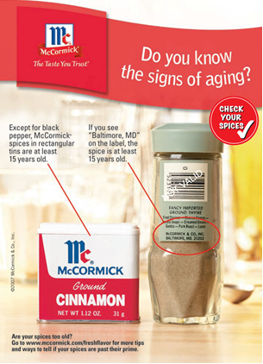
CORE CURRICULUM
Primarily Cognitive Appeal: McCormick Spice Advertisement
Source: McCormick & Co., Inc. © 2006.
John T. Gourville and Michael I. Norton, Core Reading: Consumer Behavior and the Buying Process, HBP No. 8167 (Boston: Harvard Business School Publishing, 2019). Copying or posting is an infringement of copyright.

Slide 4

CORE CURRICULUM
A Blend of Cognitive and Emotional Appeal: Ram Truck Advertisement
Source: “Horsepower National Park,” Ram Trucks advertisement, reproduced by permission of Chrysler Group LLC.
John T. Gourville and Michael I. Norton, Core Reading: Consumer Behavior and the Buying Process, HBP No. 8167 (Boston: Harvard Business School Publishing, 2019). Copying or posting is an infringement of copyright.

Slide 5

CORE CURRICULUM
“Precision Parking”: Advertising with Primarily Emotional Appeal
Source : VW ad 2012, https://www.adsoftheworld.com/media/print/volkswagen_hedgehog_and_fish, accessed December 10, 2019.
John T. Gourville and Michael I. Norton, Core Reading: Consumer Behavior and the Buying Process, HBP No. 8167 (Boston: Harvard Business School Publishing, 2019). Copying or posting is an infringement of copyright.

Slide 6

CORE CURRICULUM
Making Comparisons
Source: Capital One.
John T. Gourville and Michael I. Norton, Core Reading: Consumer Behavior and the Buying Process, HBP No. 8167 (Boston: Harvard Business School Publishing, 2019). Copying or posting is an infringement of copyright.

Slide 7
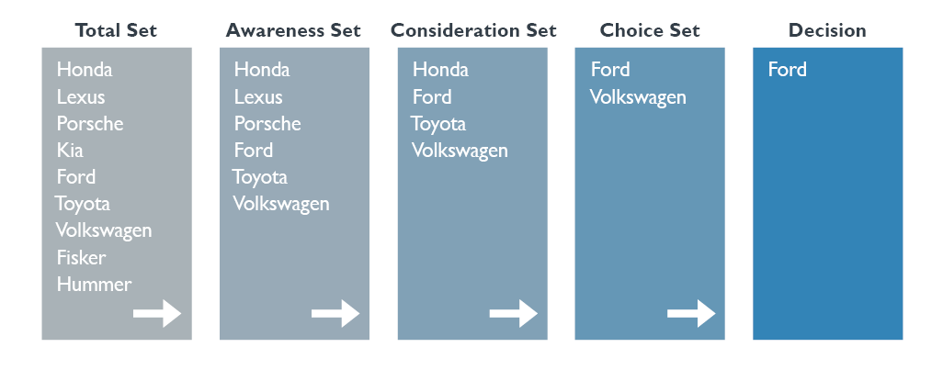
CORE CURRICULUM
Buying an Automobile: From Total Set to Decision
John T. Gourville and Michael I. Norton, Core Reading: Consumer Behavior and the Buying Process, HBP No. 8167 (Boston: Harvard Business School Publishing, 2019). Copying or posting is an infringement of copyright.

Slide 8
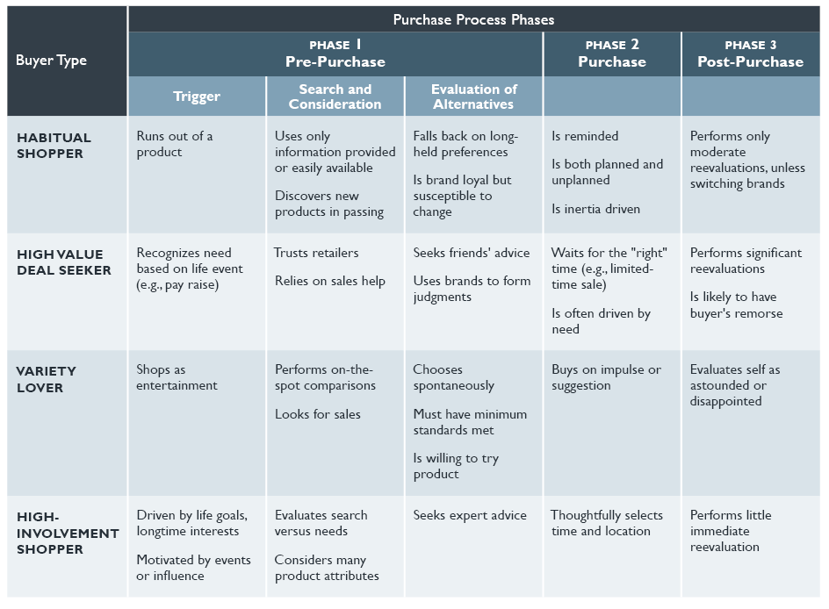
CORE CURRICULUM
Dynamics by Buyer Type Across Phases in the Purchase Process
Source: Reprinted from “The Customer Has Escaped” by Paul F. Nunes and Frank V. Cespedes, Harvard Business Review, November 2003. Copyright © 2003 by the Harvard Business Publishing Corporation; all rights reserved.
John T. Gourville and Michael I. Norton, Core Reading: Consumer Behavior and the Buying Process, HBP No. 8167 (Boston: Harvard Business School Publishing, 2019). Copying or posting is an infringement of copyright.

Slide 9
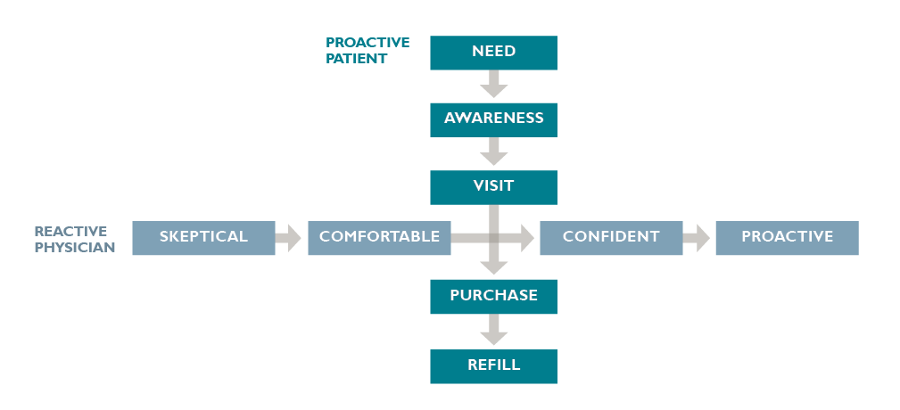
CORE CURRICULUM
The Decision-Making Process: Proactive Patients and Reactive Physicians
Source: Reprinted from Harvard Business School, “PROPECIA™: Helping Make Hair Loss History,” 506-053, by Marta Wosinska. Copyright © 2004 by the President and Fellows of Harvard College; all rights reserved.
John T. Gourville and Michael I. Norton, Core Reading: Consumer Behavior and the Buying Process, HBP No. 8167 (Boston: Harvard Business School Publishing, 2019). Copying or posting is an infringement of copyright.

